Slide 1
Docker Networking
OW

Slide 2
overview
Containers have networking enabled by default, and they can make outgoing connections.
A container has no information about what kind of network it's attached to, or whether their peers are also Docker workloads or not.
A container only sees a network interface with an IP address, a gateway, a routing table, DNS services, and other networking details. That is, unless the container uses the none network driver

Slide 3
Network Drivers
bridge: The default network driver. If you don't specify a driver, this is the type of network you are creating. Bridge networks are commonly used when your application runs in a container that needs to communicate with other containers on the same host.
host: Remove network isolation between the container and the Docker host, and use the host's networking directly.
overlay: Overlay networks connect multiple Docker daemons together and enable Swarm services and containers to communicate across nodes.

Slide 4
Networks Available
Bridge - NAT - docker0
Host - Uses host network
None - Isolated / no networking
Overlay - Swarm mode
Macvlan - Legacy applications needing direct connection to physical network
3rd party network plugins

Slide 5
docker0 - The default "Bridge" network
dockerhost ~]$ docker network ls
NETWORK ID NAME DRIVER SCOPE
ab382bcb8342 bridge bridge local
c46f23496264 host host local
2c77e24c2352 none null local

Slide 6
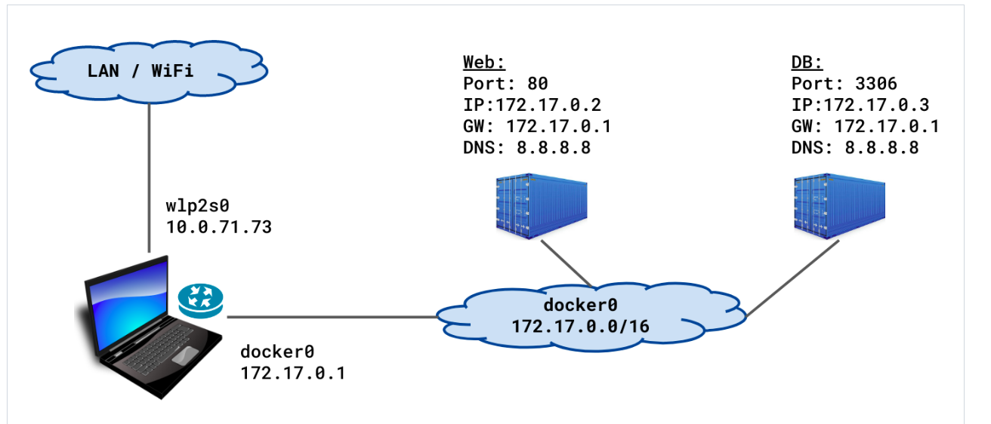
..

Slide 7
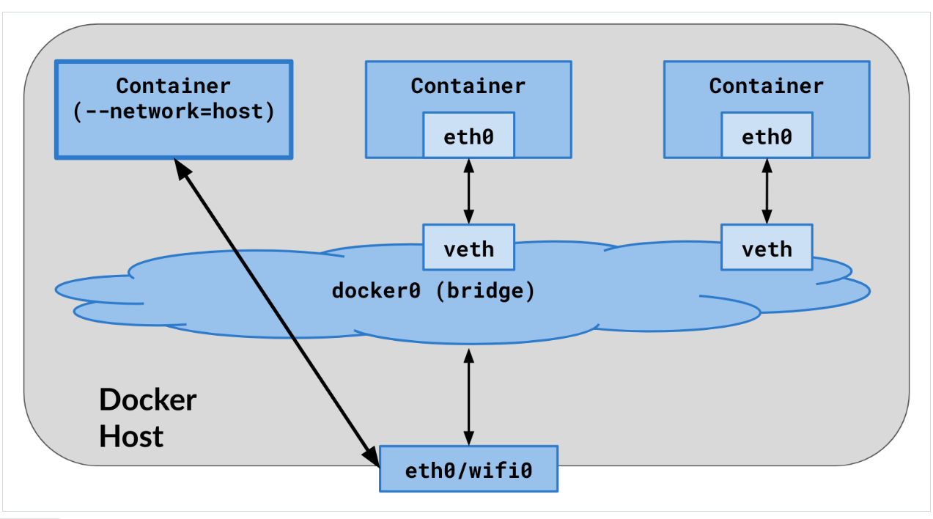
The Docker "Host" network:

Slide 8
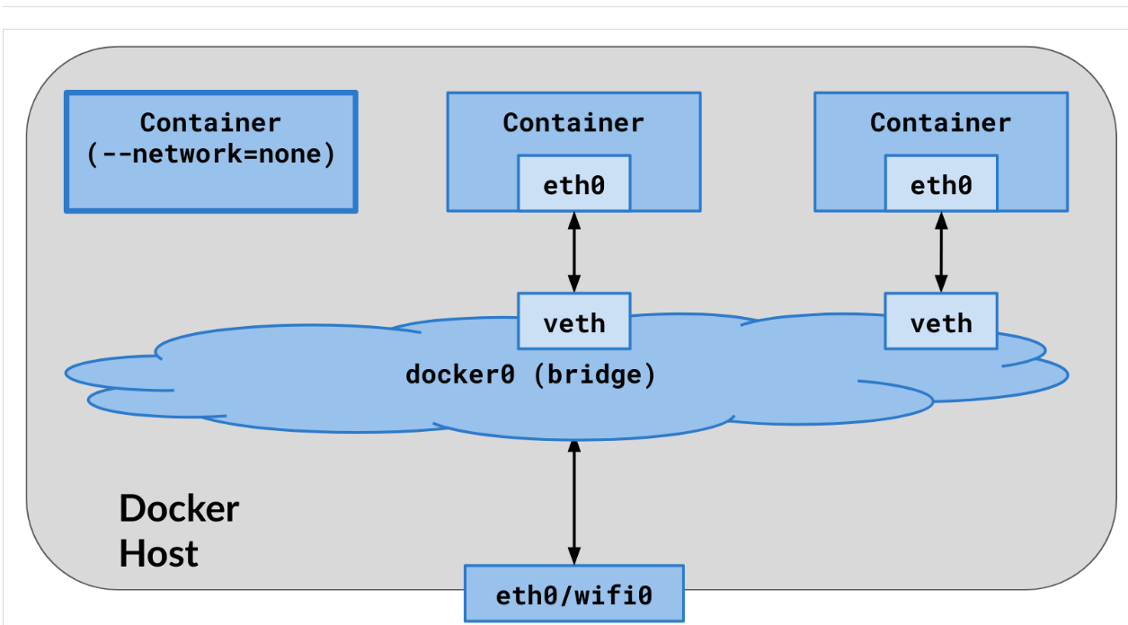
The "None" network:

Slide 9
Published Ports
By default, when you create or run a container using docker create or docker run, containers on bridge networks don't expose any ports to the outside world.
Use the --publish or -p flag to make a port available to services outside the bridge network.
This creates a firewall rule in the host, mapping a container port to a port on the Docker host to the outside world. Here are some examples:

Slide 10
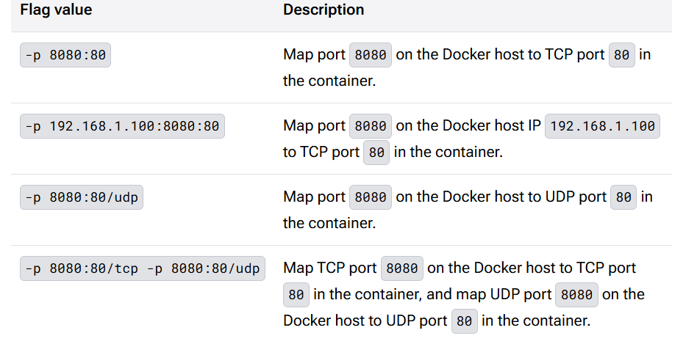
..

Slide 11
Important
Publishing container ports is insecure by default. Meaning, when you publish a container's ports it becomes available not only to the Docker host, but to the outside world as well.
If you want to make a container accessible to other containers, it isn't necessary to publish the container's ports. You can enable inter-container communication by connecting the containers to the same network, usually a bridge network.

